Slide 1
Machine Learning Models: a hands-on experience (this is just a teaser trailer!)
UniCredit Quant Community
Gabriele Bonomi Boseggia, Fabio Colombo, Luca Mammi
Milan, April 19th, 2018

Slide 2
Follow one the links! (they're equivalent)
goo.gl/GNaZ4o
goo.gl/K5SuC1

Slide 3
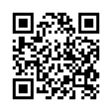
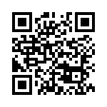
If you only have your phone, take a pic of one of the two

Slide 4
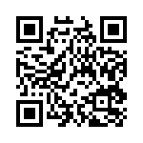
If they don't work, try this
goo.gl/wH9s3t

Slide 5
Or this

